Slide 1
DevNet Learning Forum
5 – NetDevOps

Slide 2
Agenda
Review
DevOps & NetDevOps
Ansible

Slide 3
Review

Slide 4
eem_intf_up.py
eem.conf
#! /usr/bin/env python from cli import configurep import argparse # Retrieve the interface from command line using argparse parser = argparse.ArgumentParser() parser.add_argument("interface", help="Interface to bring up") args = parser.parse_args() # List of commands to run commands = [ "interface {}".format(args.interface), "no shut" ] # Run commands using Python API # Commands need to be semicolon seperated configurep(commands)
event manager applet interface_Lo100_Shutdown event syslog pattern "Interface Loopback100, changed state to administratively down" action 0.0 cli command "en" action 1.0 cli command "guestshell run python /flash/eem_intf_up.py lo100" exit

Slide 5
DevOps & NetDevOps

Slide 6
Continuous Integration
Continuous Delivery
Continuous Deployment

Slide 9
NetDevOps

Slide 10

Mechanism = Automation
No more hand to hand combat
configuration management
Configuration Management
today is about the “tools”
Consistency
+ Scale
Success!

Slide 11




Configuration Management Tools
Automation and Orchestration
Idempotent Behavior
Facts, lots of facts
Modules and Libraries
Open Source Foundation

Slide 12
Matrix of Common Info and Terms
 | Puppet | Ansible | Chef | SaltStack
Language | Ruby Based | Python + YAML | Ruby | Python
Managed Node Requirements | Traditionally Agent Based | Agentless | Agent Based | Agent Based “minions”
Centralized Management | Puppet Master | Any computer can be “controller” | Chef Server | Salt Master
Script Names | Manifest / Module | Playbook / Roles | Recipe / Cookbook | Pillar / Include

Slide 13
Why Ansible for the Network?
Agentless
Currently popular in network
community
ie Lots of examples!
Written in Python
Simple to install and get started!
But explore other options as well!

Slide 14
Ansible

Slide 15


Real-Time Remote Execution of Commands
ansible -m shell -a “netstat -rn” datacenter-east
1. Audit routes on all
virtual machines
VM-1
VM-2
…
VM-98
2. Updates routes
required for consistency
VM-99
VM-100
ansible -m shell -a “route add X.X.X.X” datacenter-east
© 2017 Cisco and/or its affiliates. All rights reserved. Cisco Confidential

Slide 16

Change Control Workflow Orchestration
2. Update load balancer
pools to point to stage
Production
VM-1
VM-2
LB-1
…
LB-2
VM-B
VM-A
1. Deploy application change
to stage and verify
Stage
© 2017 Cisco and/or its affiliates. All rights reserved. Cisco Confidential

Slide 17




How does Ansible work?
1. Engineers deploy Ansible playbooks written in YAML to a
control station
DB-1
DB-2
WEB-1
WEB-2
APP-2
APP-1
2. Ansible copies modules typically written in Python to remote hosts to execute tasks
Ansible Control Station
© 2017 Cisco and/or its affiliates. All rights reserved. Cisco Confidential

Slide 18

Inside the Ansible Control Station
Linux host with a Python and
the Ansible installed
Support transport to remote
hosts
Typically SSH but could use an API
Ansible Components
Ansible configuration file
Inventory files
Ansible modules
Playbooks
© 2017 Cisco and/or its affiliates. All rights reserved. Cisco Confidential

Slide 19
Installing Ansible
Python 2.6 or 2.7
Python 3 support currently in “tech
preview”
pip install ansible
DevNet$ python --version Python 2.7.12
DevNet$ pip install ansible Collecting ansible
Downloading ansible-2.3.1.0.tar.gz (4.3MB)
100% |████████████████████████████████| 4.3MB
283kB/s
.
.
.
Successfully built ansible
Installing collected packages: ansible Successfully installed ansible-2.3.1.0 DevNet$
Output edited for brevity and clarity
© 2017 Cisco and/or its affiliates. All rights reserved. Cisco Confidential

Slide 20
Ansible Configuration File
Control operation of Ansible
Default configuration
/etc/ansible/ansible.cfg
Override default settings
ANSIBLE_CONFIG ENV
ansible.cfg in current directory
.ansible.cfg in home directory
See Ansible documentation for all options
DevNet$ cat ansible.cfg
# config file for ansible
# override global certain global settings
[defaults]
# default to inventory file of ./hosts inventory = ./hosts
# disable host checking to automatically add
# hosts to known_hosts host_key_checking = False
# set the roles path to the local directory roles_path = ./
http://docs.ansible.com/ansible/latest/intro_configuration.html
© 2017 Cisco and/or its affiliates. All rights reserved. Cisco Confidential
netprog_basics/netdevops/ansible_part_1/ansible.cfg

Slide 21
Ansible Authentication Basics
DevNet$ ssh-keygen Generating public/private rsa key pair. Enter file in which to save the key: Enter passphrase (empty for no passphrase): Enter same passphrase again: Your identification has been saved in ~/.ssh/id_rsa. Your public key has been saved in ~/.ssh/id_rsa.pub.
DevNet$ ssh-copy-id root@10.10.20.20 . Number of key(s) added: 1 Now try logging into the machine, with: "ssh 'root@10.10.20.20'"
DevNet$ ssh root@10.10.20.20 Last login: Fri Jul 28 13:33:46 2017 from 10.10.20.7 (python2) [root@localhost sbx_nxos]#
Typically, Ansible uses SSH for authentication and assumes keys are in place
Setting up and transferring SSH keys allows playbooks to be run automatically
Using passwords is possible
Network Devices often use passwords
Output edited for brevity and clarity
© 2017 Cisco and/or its affiliates. All rights reserved. Cisco Confidential

Slide 22
Ansible Inventory File
Inventory file identifies hosts, and groups of hosts under management
Hosts can be IP or FQDN
Groups enclosed in []
Can include host specific parameters as well
Example: Instructing Ansible to use the active Python Interpreter when using Python
Virtual Environments
DevNet$ cat hosts
[servers]
10.10.20.20
ansible_python_interpreter="/usr/bin/env python"
[switches]
172.16.30.101
172.16.30.102
172.16.30.103
172.16.30.104
ansible_python_interpreter="/usr/bin/env python"
ansible_python_interpreter="/usr/bin/env python" ansible_python_interpreter="/usr/bin/env python" ansible_python_interpreter="/usr/bin/env python"
Output edited for brevity and clarity
netprog_basics/netdevops/ansible_part_1/hosts
© 2017 Cisco and/or its affiliates. All rights reserved. Cisco Confidential

Slide 23
Ansible CLI Tool Overview
Tool | Description
ansible | Executes modules against targeted hosts without creating playbooks.
ansible-playbook | Run playbooks against targeted hosts.
ansible-vault | Encrypt sensitive data into an encrypted YAML file.
ansible-pull | Reverses the normal “push” model and lets clients "pull" from a centralized server for execution.
ansible-docs | Parses the docstrings of Ansible modules to see example syntax and the parameters modules require.
ansible-galaxy | Creates or downloads roles from the Ansible community.
© 2017 Cisco and/or its affiliates. All rights reserved. Cisco Confidential

Slide 24
Using Ansible CLI for ad-hoc Commands
DevNet$ ansible -m setup -u root servers
10.10.20.20 | SUCCESS => {
"ansible_facts": {
"ansible_all_ipv4_addresses": [
"10.10.20.20",
"172.17.0.1"
],
"ansible_all_ipv6_addresses": [ "fe80::250:56ff:febb:3a3f"
],
"ansible_apparmor": { "status": "disabled"
},
"ansible_architecture": "x86_64",
.
.
Output edited for brevity and clarity
Quickly run a command against a set
of hosts
Specify the module with –m module
Specfiy the username to use with
–u user
Default is to use local username
Specify the server or group to target
Provide module arguments with
–a argument
© 2017 Cisco and/or its affiliates. All rights reserved. Cisco Confidential

Slide 25

Demo Time!
ad-hoc command
© 2017 Cisco and/or its affiliates. All rights reserved. Cisco Confidential

Slide 26
Ansible Terms
Tool | Description
module | Code, typically written in Python, that will perform some action on a host. Example: yum - Manages packages with the yum package manager
task | A single action that references a module to run along with any input arguments and actions
play | Matching a set of tasks to a host or group of hosts
playbook | A YAML file that includes one or more play
role | A pre-built set of playbooks designed to perform some standard configuration in a repeatable fashion. A play could leverage a role rather than tasks. Example: A role to configure a web server would install Apache, configure the firewall, and copy application files.
© 2017 Cisco and/or its affiliates. All rights reserved. Cisco Confidential
http://docs.ansible.com/ansible/latest/list_of_all_modules.html http://docs.ansible.com/ansible/latest/playbooks.html

Slide 27
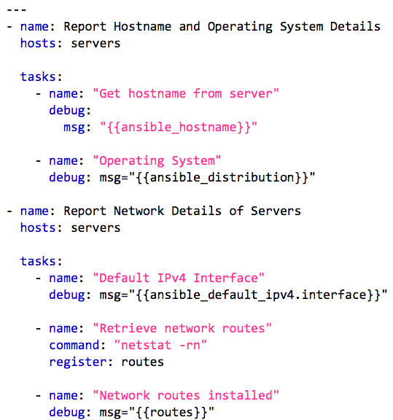
Ansible Playbooks
Written in YAML
One or more plays that contain hosts and tasks
Tasks have a name & module keys.
Modules have parameters
Variables referenced with {{name}}
Ansible gathers “facts”
Create your own by register-ing
output from another task
http://docs.ansible.com/ansible/latest/YAMLSyntax.html
© 2017 Cisco and/or its affiliates. All rights reserved. Cisco Confidential
netprog_basics/netdevops/ansible_part_1/example1.yaml

Slide 28
Ansible Playbooks
DevNet$ ansible-playbook -u root example1.yaml
PLAY [Report Hostname and Operating System Details]
*********************************************************************************************** TASK [Gathering Facts]
*****************************************************************************************************
ok: [10.10.20.20]
TASK [Get hostname from server]
*****************************************************************************************************
ok: [10.10.20.20] => {
"msg": "localhost"
}
PLAY [Report Network Details of Servers]
***************************************************************************************************** TASK [Network routes installed]
*****************************************************************************************************ok:
[10.10.20.20] => {
"stdout_lines": [
"Kernel IP routing table",
 | "Destination | Gateway | Genmask | Flags | MSS | Window | irtt | Iface",
 | "0.0.0.0 | 10.10.20.254 | 0.0.0.0 | UG | 0 | 0 | 0 | ens160",
 | "10.10.20.0 | 0.0.0.0 | 255.255.255.0 | U | 0 | 0 | 0 | ens160",
 | "172.16.30.0 | 10.10.20.160 | 255.255.255.0 | UG | 0 | 0 | 0 | ens160",
]
PLAY RECAP
*********************************************************************************************************************
*******************
10.10.20.20 : ok=7 changed=1 unreachable=0 failed=0
© 2017 Cisco and/or its affiliates. All rights reserved. Cisco Confidential
Output edited for brevity and clarity

Slide 29
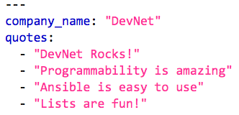
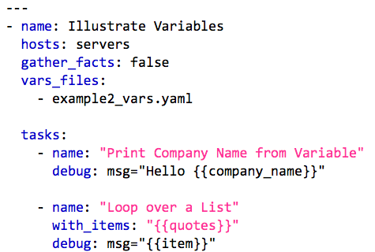
Using Variable Files and Loops with Ansible
example2_vars.yaml
Include external variable files using
vars_files: filename.yaml
Reference variables with
{{name}}
YAML supports lists and hashes (ie key/value)
Loop to repeat actions with
with_items: variable
© 2017 Cisco and/or its affiliates. All rights reserved. Cisco Confidential
netprog_basics/netdevops/ansible_part_1/example2.yaml
netprog_basics/netdevops/ansible_part_1/example2_vars.yaml

Slide 30
Using Variable Files and Loops with Ansible
DevNet$ ansible-playbook -u root example2.yaml
PLAY [Illustrate Variables] **************************
TASK [Print Company Name from Variable] ************** ok: [10.10.20.20] => {
"msg": "Hello DevNet"
}
TASK [Loop over a List] ****************************** ok: [10.10.20.20] => (item=DevNet Rocks!) => {
"item": "DevNet Rocks!",
"msg": "DevNet Rocks!"
}
ok: [10.10.20.20] => (item=Programmability is amazing) => {
"item": "Programmability is amazing",
"msg": "Programmability is amazing"
}
ok: [10.10.20.20] => (item=Ansible is easy to use) => {
"item": "Ansible is easy to use",
"msg": "Ansible is easy to use"
}
ok: [10.10.20.20] => (item=Lists are fun!) => {
"item": "Lists are fun!", "msg": "Lists are fun!"
}
© 2017 Cisco and/or its affiliates. All rights reserved. Cisco Confidential

Slide 31
Host and Group Variables
Ansible allows for Group and
Host specific variables
group_vars/groupname.yaml
host_vars/host.yaml
Variables automatically available
├── group_vars
│ └── all.yaml
│ └── switches.yaml
├── host_vars
│ ├── 172.16.30.101.yaml
│ ├── 172.16.30.102.yaml
│ ├── 172.16.30.103.yaml
│ └── 172.16.30.104.yaml
© 2017 Cisco and/or its affiliates. All rights reserved. Cisco Confidential

Slide 32
Demo Time!
var_demo.yml
© 2017 Cisco and/or its affiliates. All rights reserved. Cisco Confidential

Slide 33
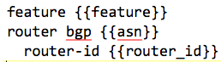
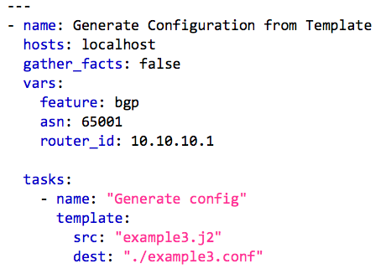
Jinja2 Templating – Variables to the Max!
Not just for Ansible templates
Powerful templating language
Loops, conditionals and more
supported
Leverage template module
Attributes
src: The template file
dest: Where to save generated
template
example3.j2
http://docs.ansible.com/ansible/latest/playbooks_templating.html
© 2017 Cisco and/or its affiliates. All rights reserved. Cisco Confidential

Slide 34
Jinja2 Templating – Variables to the Max!
DevNet$ ansible-playbook -u root example3.yaml
PLAY [Generate Configuration from Template] ********************************
TASK [Generate config] *****************************************************
changed: [localhost]
PLAY RECAP *****************************************************************
localhost : ok=1 changed=1 unreachable=0 failed=0
DevNet$ cat example3.conf
feature bgp router bgp 65001
router-id 10.10.10.1
© 2017 Cisco and/or its affiliates. All rights reserved. Cisco Confidential

Slide 35
Demo Time!
template_demo.yml
© 2017 Cisco and/or its affiliates. All rights reserved. Cisco Confidential

Slide 36



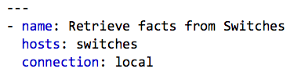



Ansible and Networking
1. Engineers deploy Ansible playbooks written in YAML to a
control station
2. Ansible executes modules locally
using APIs to interface with devices
Ansible Control Station
© 2017 Cisco and/or its affiliates. All rights reserved. Cisco Confidential

Slide 37
Review: Installing Ansible
Python 2.6 or 2.7
Python 3 support currently in “tech
preview”
pip install ansible
DevNet$ python --version Python 2.7.12
DevNet$ pip install ansible Collecting ansible
Downloading ansible-2.3.1.0.tar.gz (4.3MB)
100% |████████████████████████████████| 4.3MB
283kB/s
.
.
.
Successfully built ansible
Installing collected packages: ansible Successfully installed ansible-2.3.1.0 DevNet$
Output edited for brevity and clarity
© 2017 Cisco and/or its affiliates. All rights reserved. Cisco Confidential

Slide 38
Review: Ansible Configuration File
Control operation of Ansible
Default configuraiton
/etc/ansible/ansible.cfg
Override default settings
ANSIBLE_CONFIG ENV
ansible.cfg in current directory
.ansible.cfg in home directory
See Ansible documentation for all options
DevNet$ cat ansible.cfg
# config file for ansible
# override global certain global settings
[defaults]
# default to inventory file of ./hosts inventory = ./hosts
# disable host checking to automatically add
# hosts to known_hosts host_key_checking = False
# set the roles path to the local directory roles_path = ./
http://docs.ansible.com/ansible/latest/intro_configuration.html
© 2017 Cisco and/or its affiliates. All rights reserved. Cisco Confidential
netprog_basics/netdevops/ansible_part_2/ansible.cfg

Slide 39
Review: Ansible Inventory File
Inventory file identifies hosts, and groups of hosts under management
Hosts can be IP or FQDN
Groups inclosed in []
Can include host specific parameters as well
Example: Instructing Ansible to use the active Python Interpreter when using Python
Virtual Environments
DevNet$ cat hosts
[servers]
10.10.20.20 ansible_python_interpreter="/usr/bin/env python"
[switches] 172.16.30.101
172.16.30.102
172.16.30.103
172.16.30.104
ansible_python_interpreter="/usr/bin/env python"
ansible_python_interpreter="/usr/bin/env python" ansible_python_interpreter="/usr/bin/env python" ansible_python_interpreter="/usr/bin/env python"
Output edited for brevity and clarity
netprog_basics/netdevops/ansible_part_2/hosts
© 2017 Cisco and/or its affiliates. All rights reserved. Cisco Confidential

Slide 40
Network Authentication
Many network modules and require username and password for authentication
Use Ansible environment variables to set
export ANSIBLE_NET_USERNAME=cisco
export ANSIBLE_NET_PASSWORD=cisco
Suggest creating and sourcing a file
to simplify
DevNet$ cat .ansible_env
# Setup environment for ansible playbooks
# Credentials for DevNet Open NX-OS Sandbox
# https://devnetsandbox.cisco.com/
# usage: source .ansible_env
# Authentication for ansible network modules export ANSIBLE_NET_USERNAME=cisco
export ANSIBLE_NET_PASSWORD=cisco
DevNet$ source .ansible_env
DevNet$ echo $ANSIBLE_NET_USERNAME
cisco
© 2017 Cisco and/or its affiliates. All rights reserved. Cisco Confidential
netprog_basics/netdevops/ansible_part_2/.ansible_env

Slide 41
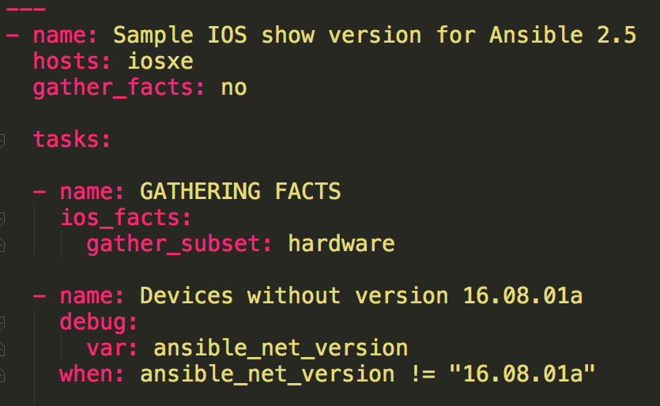
ios_facts
Used for gathering information about the platform
Sets standard variables for use in subsequent tasks, such as ansible_net_version
Subsets of facts can be gathered as needed. For example, subset: hardware
Notes:
ios_facts
The `ios_facts` module gathers basic facts about the remote IOS device it is connecting to. This information can in turn be used as a variable or in a conditional statement later in the playbook. The data this module collects will be stored as variables with the prefix `ansible_net_`.
---
- name: Sample IOS show version for Ansible 2.5
hosts: iosxe
gather_facts: no
tasks:
- name: GATHERING FACTS
ios_facts:
gather_subset: hardware
- name: Devices without version 16.08.01a
debug:
var: ansible_net_version
when: ansible_net_version != "16.08.01a"
In this play, we gather the version of each device. We then check the `ansible_net_version` variable, which was set by `ios_facts`, and if it is not equal to `16.08.01a` we print out the current running version.
Taking it a step at a time, we start our play with a single `-` to define the beginning of a play.
-
Next, we tell the play to execute against all hosts in group `iosxe`.
hosts: iosxe
We then tell it we will be running a set of `tasks:`.
tasks:
Our first task is calling the `ios_facts` module that is included in Ansible by default:
ios_facts:
We then tell it to only gather hardware details about each platform:
gather_subset: hardware
At this point, the `ios_facts` module will save all of the hardware details about the platform into variables that can be referenced by other tasks.
Next we call the `debug` module, which is also included in Ansible by default and is often used for logging output to the console:
debug:
And with the `debug` module we will print out the IOS version we learned from `ios_facts`.
var: ansible_net_version
But, with the `when` condition, we are choosing to execute this debug output only when the detected version is not `16.08.01a`:
when: ansible_net_version != "16.08.01a"

Slide 42
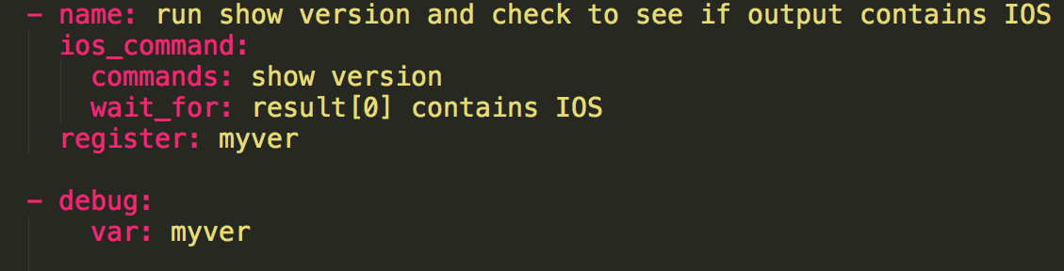
ios_command
Catch-all for running arbitrary commands on IOS
Can run one command, or a list of multiple commands
Returns raw text, so less convenient to work with than something like ios_facts
Notes:
ios_command
The `ios_command` module is designed to send arbitrary commands to an IOS device and retrieve the response. This module is commonly used to gather output from `show` commands and store it in variables.
- name: run show version and check to see if output contains IOS
ios_command:
commands: show version
wait_for: result[0] contains IOS
register: myver
- debug:
var: myver
In this example we run a `show version`, store the output as `myvar`, and print the output. Once it is stored in a variable, we could also reference the contents of the variable in future plays.
It is worth noting, as you will see in subsequent labs, the output of this module is a representation of the multi-line CLI output. Because it is not a native data structure, it can be more difficult to work with than the output of something like `ios_facts`, which returns much of the same information as individual variables such as `ansible_net_version`.

Slide 43
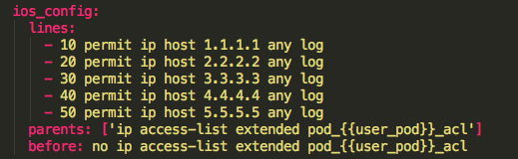
ios_config
Catch-all for running arbitrary config commands on IOS
Can run a single config command, or multiple config commands
Can run [nearly] every config command, but many will not be idempotent
Has optional parameters “parents” to handle nested commands such as lines within an ACL and “before” to do a task first such as deleting any existing ACL before creating
Notes:
ios_config
tasks:
- name: Base config template
ios_config:
lines:
- logging buffered 10240
- service timestamps debug datetime msec localtime show-timezone
- service timestamps log datetime msec localtime show-timezone
In this example we use the `ios_config` module to apply several config commands to the device. The `ios_config` module is idempotent for many, but not all commands. As a result, it is generally best to choose a more specific module if it is available. A good example would be `ios_user` instead of creating users with `ios_config`.

Slide 44
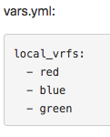
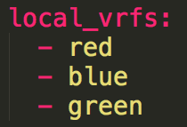
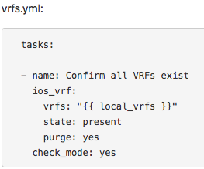
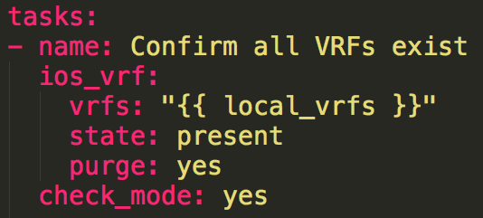
ios_vrf
Configure VRFs on an IOS device
Supports passing in a hash for multiple VRFs
Supports “purge”, aka declarative mode
This play shows optional “check_mode”, which only reports on what it would do. It does not actually make changes when set.
Notes:
ios_vrf
vars.yml:
local_vrfs:
- red
- blue
- green
As you can see, we start by setting up a `local_vrfs` list that currently has 3 VRFs defined in it. This definition could be whatever is most reusable, whether that is a global variable file, a group variable file, or a host variable file.
vrfs.yml:
tasks:
- name: Confirm all VRFs exist
ios_vrf:
vrfs: "{{ local_vrfs }}"
state: present
purge: yes
check_mode: yes
In this example we are using the `ios_vrf` module to declare which VRFs we want to exist on the router. Because we use the optional `purge: yes` parameter, the `ios_vrf` module will delete any additional VRFs from the device that are not included in ``{{ local_vrfs }}`` address defined in our variable file.
vrfs: "{{ local_vrfs }}"
Here we pass a list variable that contains a list of VRFs as a parameter to `ios_vrf`.
state: present
This line specifies that we want to ensure these VRFs exist. In contrast, `state: absent` would delete this list of VRFs.
purge: yes
We are telling the module that the list of VRFs in `local_vrfs` should be a complete list, and any additional VRFs that exist on the device should be removed.
check_mode: yes
This is a useful parameter that tells the task to only evaluate what it would do, without taking action. It is very useful for testing new script changes or just for building a script to audit devices. It behaves similar to the ``-C`` command-line option, but can be specified on individual tasks unlike ``-C``.

Slide 45
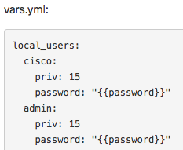
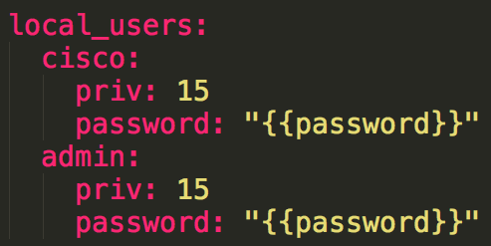
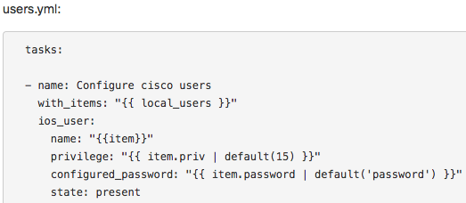
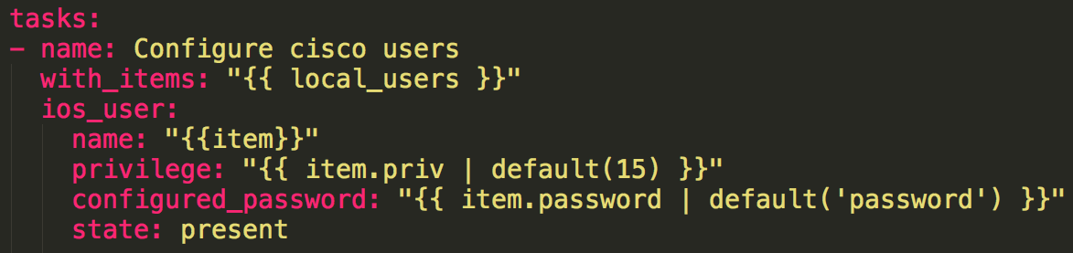
ios_user
Configure local users on IOS device
This play shows an example of looping over a nested data structure to configure multiple users
Notes:
ios_user
vars.yml:
local_users:
cisco:
priv: 15
password: "{{password}}"
admin:
priv: 15
password: "{{password}}"
users.yml:
tasks:
- name: Configure cisco users
with_items: "{{ local_users }}"
ios_user:
name: "{{item}}"
privilege: "{{ item.priv | default(15) }}"
configured_password: "{{ item.password | default('password') }}"
state: present
In this example, we leverage a variable named `{{local_users}}` created in a group variable file. The play loops through all users within the list and creates a user with the correct privilege and password. If not specified, privilege defaults to `15` and password to `password`.

Slide 46
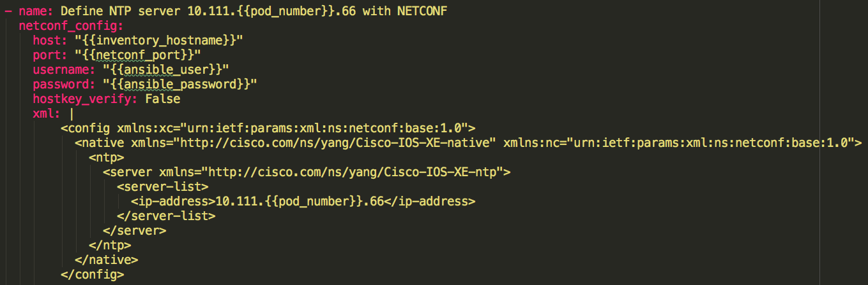
netconf_config
Allows configuration of multiple different platforms leveraging a single supported YANG data model
Notes:
netconf_config
The last module we will cover, `netconf_config`, is unique in that it is not specific to one platform. The `netconf_config` module can talk to any NETCONF-capable device, allowing for more universal tasks across multiple platforms. In the following example, we use NETCONF to define an NTP server on a router.
---
- name: NETCONF create NTP server
hosts: iosxe
connection: local
gather_facts: False
tasks:
- set_fact:
ansible_connection: local
- name: Define NTP server 10.111.{{pod_number}}.66 with NETCONF
netconf_config:
host: "{{inventory_hostname}}"
port: "{{netconf_port}}"
username: "{{ansible_user}}"
password: "{{ansible_password}}"
hostkey_verify: False
xml: |
<config xmlns:xc="urn:ietf:params:xml:ns:netconf:base:1.0">
<native xmlns="http://cisco.com/ns/yang/Cisco-IOS-XE-native" xmlns:nc="urn:ietf:params:xml:ns:netconf:base:1.0">
<ntp>
<server xmlns="http://cisco.com/ns/yang/Cisco-IOS-XE-ntp">
<server-list>
<ip-address>10.111.{{pod_number}}.66</ip-address>
</server-list>
</server>
</ntp>
</native>
</config>
hosts: iosxe
connection: local
As with past examples, we apply this play to the group `iosxe`.
- set_fact:
ansible_connection: local
Unlike the `ios_` modules which support connection type `network_cli`, starting in Ansible 2.5, the `netconf_config` module currently relies on setting your ansible_connection type to `local`. Because we set type to `network_cli` globally, we override that value for this playbook with `set_facts`.
netconf_config:
host: "{{inventory_hostname}}"
port: "{{netconf_port}}"
username: "{{ansible_user}}"
password: "{{ansible_password}}"
hostkey_verify: False
Because it is built on SSH connectivity, the `netconf_config` module requires that you to specify the host, port, username, and password.
xml: |
<config xmlns:xc="urn:ietf:params:xml:ns:netconf:base:1.0">
<native xmlns="http://cisco.com/ns/yang/Cisco-IOS-XE-native" xmlns:nc="urn:ietf:params:xml:ns:netconf:base:1.0">
<ntp>
<server xmlns="http://cisco.com/ns/yang/Cisco-IOS-XE-ntp">
<server-list>
<ip-address>10.111.{{pod_number}}.66</ip-address>
</server-list>
</server>
</ntp>
</native>
</config>
Lastly, the `netconf_config` module requires an XML block with the config to be sent to the device. For background on how to build the XML config, please review the Introduction to Model Driven Programmability Module.

Slide 47


Use our Ansible Mastery!
Inventory File
List network devices
Logically group for configuration
Host/Group Variable Files
Device specific details
General group details
Ansible Roles
Align to network roles
Ansible Playbook
Run roles against relevant groups
© 2017 Cisco and/or its affiliates. All rights reserved. Cisco Confidential

Slide 48
Demo Time!
network_deploy.yml
© 2017 Cisco and/or its affiliates. All rights reserved. Cisco Confidential

Slide 49
Ansible Working Directory
./
|-- ansible.cfg << ansible config file
|-- bgp_temp.j2
|-- config
|-- group_vars << group variables
| |-- all.yml
| |-- c9k.yml
| `-- csr.yml
|-- host_vars << host variables
| |-- 10.124.38.14.yml
| |-- 10.124.41.180.yml
| `-- 10.124.41.193.yml
|-- hosts << inventory file
|-- playbooks << playbooks
| |-- enable_api_demo.yml
| |-- ios_facts_demo.yml
| |-- network_deploy.yml << demo playbook
| |-- template_demo.yml
| `-- var_demo.yml
`-- roles << roles
|-- <sniped>
Reusable roles target specific
network configuration
Start with enabling APIs for use
Different groups will get different
roles
© 2017 Cisco and/or its affiliates. All rights reserved. Cisco Confidential

Slide 50
Ansible Roles Per Feature
roles/
|-- iosxe_banner
| |-- tasks
| | `-- main.yml
| `-- vars
| `-- main.yml
|-- iosxe_logging
| |-- tasks
| | `-- main.yml
| `-- vars
| `-- main.yml
|-- iosxe_mdp
| |-- tasks
| | `-- main.yml
| `-- vars
| `-- main.yml
|-- iosxe_ntp
| |-- tasks
| | `-- main.yml
| `-- vars
| `-- main.yml
|-- iosxe_vlans
| |-- tasks
| | `-- main.yml
| `-- vars
| `-- main.yml
`-- iosxe_vrf
|-- tasks
| `-- main.yml
`-- vars
`-- main.yml
Reusable roles target specific
network configuration
Start with enabling APIs for use
Different groups will get different
roles
© 2017 Cisco and/or its affiliates. All rights reserved. Cisco Confidential

Slide 51
Summary
NetDevOps
CM Tools
Agent Based
Agentless
Ansible
inventory
playbook
play, task, module
configuration
vars
roles

Slide 52
Hands-on
Use ios_config module to add an ACL to target device. The ACL should be named as “{{device_hostname}}_acl”
Make sure there’s no ACL using the same ACL name
The ACL should allow traffic from network 10.1.1.0/24, 10.1.2.0/24 to any destination
Create role and playbook to finish this task

Slide 53
Continue to study..
Learn network programmability basics (DevNet Video Courses)
https://developer.cisco.com/video/net-prog-basics/
Python Tutorial
https://www.learnpython.org/

